Slide 1
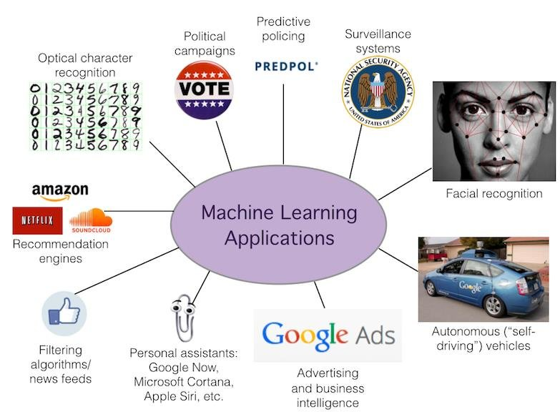

Slide 2
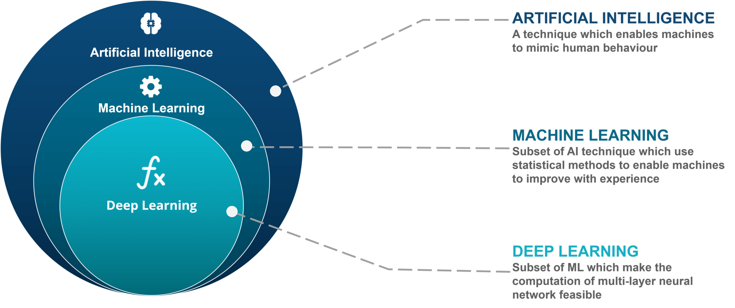

Slide 3
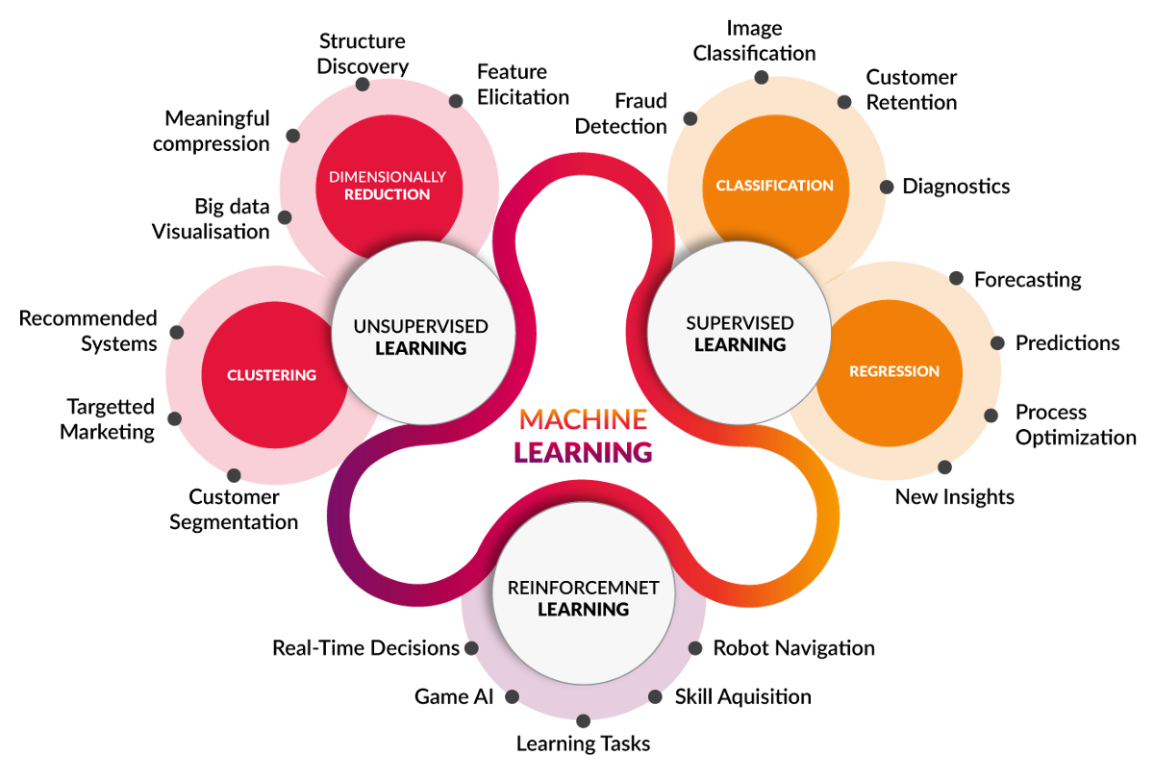

Slide 4
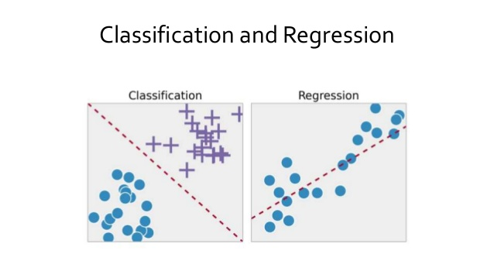

Slide 5
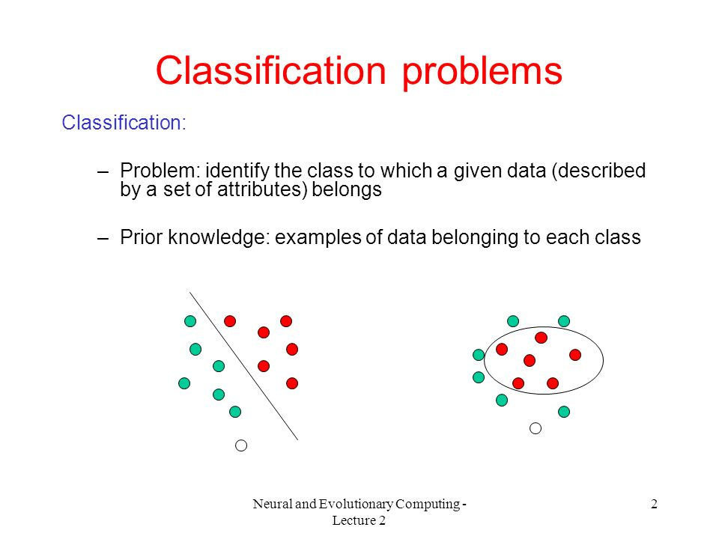

Slide 6
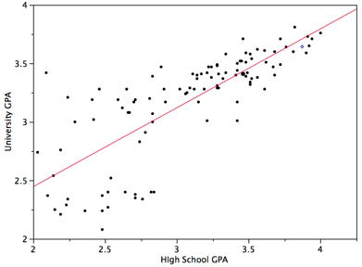

Slide 7
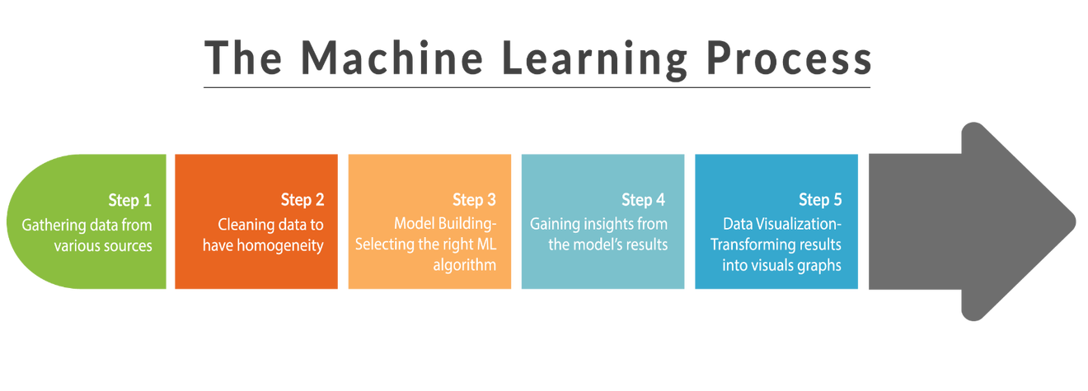

Slide 8
Should you do Machine Learning?

Slide 9
Your Minor and your Major.
Data Science Competitions on Kaggle and AnalyticsVidhya.
(can you make a looooooooooooot of money)
Getting into Development Early.
Presentable and deployable projects to put on your resume.
Can also be used to make your own Jarvis.

Slide 10
Lets get one little problem done y’all!

Slide 11
Numpy
https://drive.google.com/file/d/19da7P7eYXkx_h-_lRg0X-KR6s8Mied7A/view

Slide 12
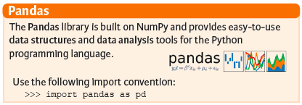
Pandas

Slide 13
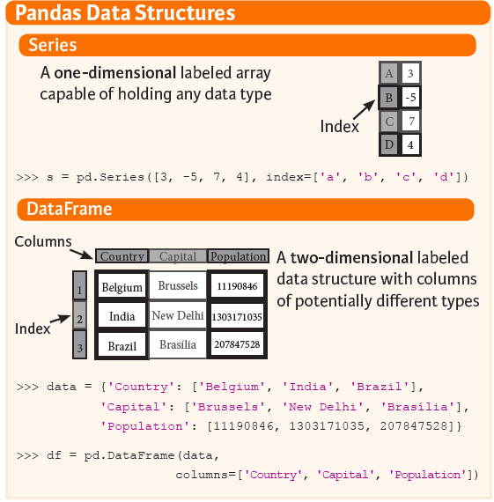

Slide 14
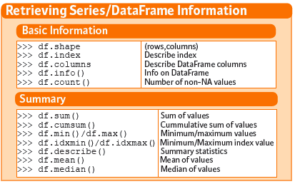

Slide 15
Sources to study from:
- KDNuggets
- Pythonprogramming.net
- Kaggle
- GFG
- Just google it.

